Slide 1
Ensuring Accessibility Through Canvas Course Design
Tina Swanton

Slide 2
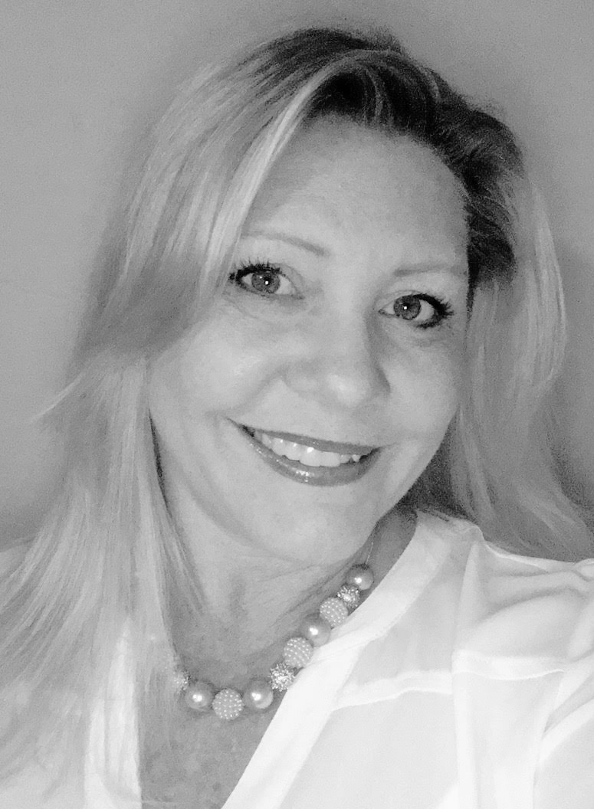
Tina Swanton
CURRENT ROLE: Learning Consultant
YEARS AT INSTRUCTURE: < 1
YEARS IN EDUCATION: 19
B.A. in Psychology from Florida Atlantic University
M.S. in Instructional Design from Saint Leo University
Secondary Teacher, Instructional Facilitator, Online Course Designer
Avid birdwatcher and kayaker
“Tina is very knowledgeable and has been instrumental in designing,
developing and delivering trainings, as well as, providing strategies
to help our team implement Canvas.”
Notes:
Now tell me a little bit about you. Drop an emoji in the chat or use a Zoom reaction.

Slide 3
AGENDA
Understand what Web Accessibility means and why it matters
Examine accessibility frameworks
Review 5 accessibility best practices
Learn about Canvas’ built in accessibility features:
Accessibility Checker
Link Validator
Immersive Reader
Explore tips for designing:
Pages
Assignments
Discussions
Quizzes
Complete the accessibility course standards section of your Curriculum Strategy Plan
Notes:
Please open a course you are working on in a new tab.

Slide 4
ACCESSIBILITY MATTERS
What do we mean by Web Accessibility?
Accessibility is the practice of making your online content usable by as many people as possible with the widest possible range of abilities, operating within the widest possible range of situations. Accessible content provides equal access and equal opportunity to people with diverse abilities.
Why does it matter?
Supports inclusion
Benefits all
Good course design
Legal requirement
Notes:
Web accessibility means ensuring that websites, tools, and technologies are designed and developed so that people with disabilities can use them.
More specifically, people can: perceive, understand, navigate, interact with and contribute to the online content
Web accessibility encompasses all disabilities that affect access to the Web, including:
auditory
cognitive
neurological
physical
speech
visual
Web accessibility also benefits people without disabilities, for example:
people using mobile phones, smart watches, smart TVs, and other devices with small screens, different input modes, etc.
older people with changing abilities due to ageing
people with “temporary disabilities” such as a broken arm or lost glasses
people with “situational limitations” such as in bright sunlight or in an environment where they cannot listen to audio
people using a slow Internet connection, or who have limited or expensive bandwidth
Overall, being cognizant of web accessibility is a course design best practice.

Slide 5
ACCESSIBILITY FRAMEWORKS

Slide 6
WEB CONTENT ACCESSIBILITY GUIDELINES (WCAG)
WCAG 2.1 at a Glance
Perceivable
All learners can see and hear the information
Orperable
All Learners can navigate the information independently
Understandable
Consistent and predictable design
Robust
Content works for all learners on a range of technologies including assistive technologies.
Notes:
Want to ensure the materials you create are accessible to all your learners? WCAG’s POUR principles are a great place to start. These principles define four qualities of an accessible experience and they are at the foundation of the Web Content Accessibility Guidelines (WCAG) an international standard for making web content accessible.
Perceivable content, you provide options for learners to adjust the presentation of information to suit their individual needs and preferences.
For example, a learner who is blind can use screen reader software to hear the information read aloud. Similarly, a learner who is deaf can turn on the closed captions or access a transcript for a visual alternative to audio or video. In each case, the learner will be able to access the information in a way that makes it perceivable with more than one sense.
Operable content will provide your learners options for how they can navigate and interact with the content: with a mouse, a keyboard or even voice commands.
For example, your learners with visual impairments may not be able to use a mouse to select options on the screen, but they can use keyboard shortcuts or touch gestures to navigate the content by heading or link.
Understandable content your learners can focus more of their effort on understanding the information rather than on working around barriers in the design. The content will be intuitive and behave in a predictable way for them.
You can also support understanding through the use of language that is appropriate for your audience’s reading level, as well by including explanations of new or unfamiliar content and features (acronyms and abbreviations, subject-specific jargon and idioms). This will make your content more accessible not only to learners who have cognitive or learning challenges, but also to learners with limited English proficiency.
Robust content works for your learners in a variety of web browser and devices (including tablets and smartphones).
This will accommodate their needs and preferences no matter where they access your content.
Source: AEM Center

Slide 7
P.O.U.R. TIPS
Perceivable
Add text descriptions to your images.
Include closed captions and transcripts.
Provide sufficient color contrast.
Do not use color alone.
Make your text readable and legible.
Operable
Provide a clear structure with headings.
Create descriptive links.
Check for keyboard accessibility.
Provide sufficient time.
Avoid content that flashes.
Understandable
Provide clear directions.
Aim for consistency.
Use plain language.
Identify the language.
Robust
Perform an accessibility check.
Test for accessibility with people.
Notes:
Perceivable
Operable
Understandable
Robust
Source: AEM Center

Slide 8
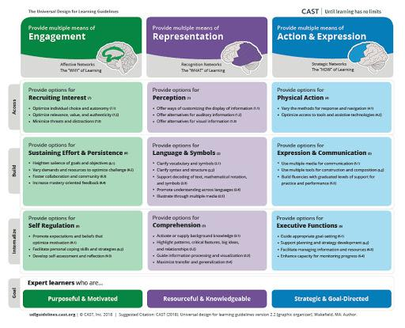
WHAT IS UNIVERSAL DESIGN FOR LEARNING
Guidelines
(in bold)
3 Principles
Click the image to view the interactive framework.
Checkpoints
(bullets)
Notes:
UDL is an approach to teaching and learning that gives all students equal opportunities to succeed.
The framework consists of 3 principles, 3 guidelines within each principle, and multiple checkpoints within each guideline.
This approach looks at the ways you can engage students, and offers flexibility in how students access material and show what they know.
UDL is K12 and Adult learners

Slide 9
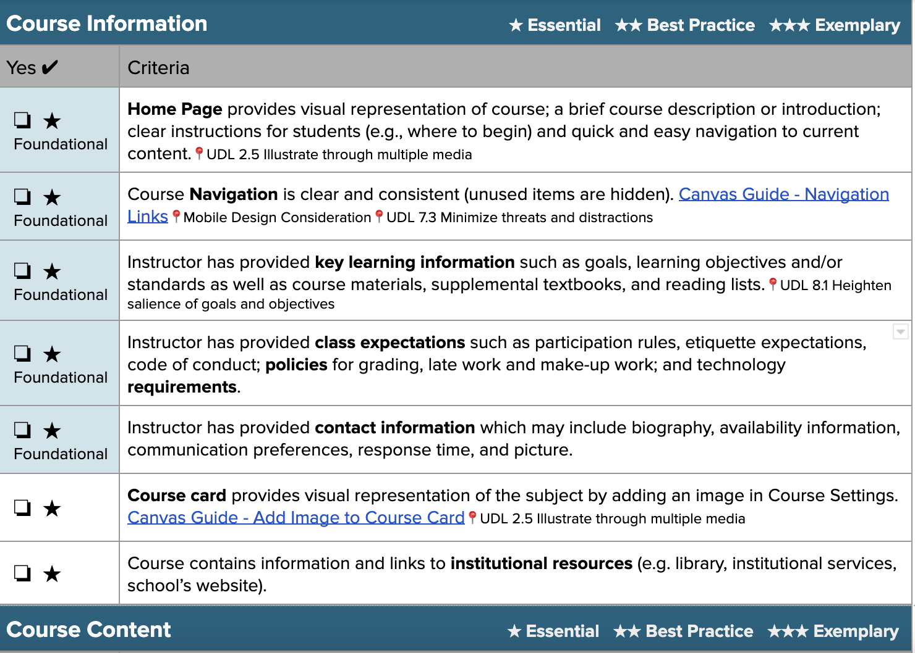
CANVAS COURSE EVALUATION & MOBILE APP CONSIDERATIONS CHECKLISTS
Click each image to access the checklist.
Notes:
The Canvas Course Evaluation Checklist can be used as is or modified to meet your needs.
You may choose to Share this checklist with your colleagues, Apply the principles to your own courses, and/or Elevate the quality of your institution’s courses by ensuring consistent course elements.
Remember you can Adapt it to meet the needs of your organization.
This document is divided into 4 sections: Course Information, Course content, Assessment of Student Learning, and Course Accessibility.
Within each section you will see a star rating system that is used to identify elements of your course as Essential, Best Practice, or Exemplary.
The checklist also includes the top 10 foundational items that should be included in a high quality course.
Today we will look at some essential and best practice elements that relate to the visual course design process.
Access
Please select the following link for access: Canvas Course Evaluation Checklist v2.0.
Please select the following link for access: Mobile App Design Course Evaluation Checklist Editable

Slide 10
5 ACCESSIBILITY BEST PRACTICES

Slide 11
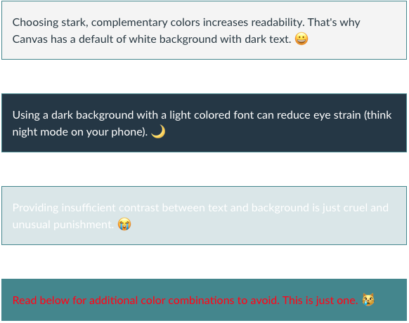
SUFFICIENT COLOR CONTRAST
TIPS FOR USING COLOR
Use simple colors
Avoid neon colors (they're hard to read and have poor contrast on a white background)
To ensure that you do have sufficient contrast, consider using the built-in Canvas Guide - Accessibility Checker or WebAIM's Color Contrast Checker.
Notes:
Color enhances the aesthetic appeal and effectiveness of the course. In Canvas, you can change the color of your text. But, be sure there is a sufficient contrast between the text color and the background color (typically white) to enhance readability, making your content Perceivable.

Slide 12
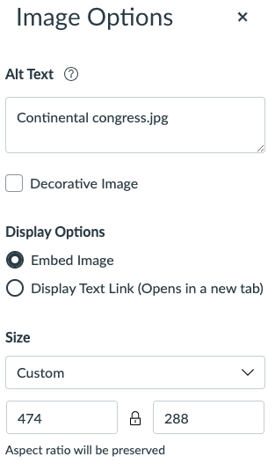
2. ADD IMAGE ALT TEXT
TIPS FOR ALT TEXT
Ensure images are supported by the content
Be succinct in your image description
Mark icons as decorative images
Check out WebAIM’s Alternative Text resource for their explanation of how to best add alt text. They also have a great article on Accessible Images
Notes:
Tagging your images with alternative text provides information for an image if a user cannot view it (due to a slow connection, an error in the src attribute, or if the user uses a screen reader). This makes content both Perceivable and Operable

Slide 13
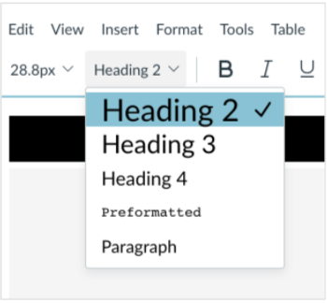
3. USE HEADING STYLES
TIPS FOR ‘STYLES’
Ensure that your content follows a linear logical layout
Structure your content using styles versus relying on text size and placement for structure
Break up content with sub-headings, images, and video
Watch this YouTube video Web Accessibility: 101 to understand how styles help when using a Screen Reader
Notes:
Using styles is the best way to create consistent, well-formatted documents and content in Canvas, and some say one of the most underused features available. Using styles makes content Operable and Understandable
The inclusion of styles (e.g., Heading 1, Heading 2, Paragraph) adds structure to your content and increases readability for people using screen readers. *Note that the Rich Content Editor in Canvas begins with Heading 2.
Styles help you maintain consistency in the most efficient manner possible.
When using styles in other software programs (e.g., Word or Google Docs) you'll see how using styles allow you to quickly create a Table of Contents and easily navigate within your document.

Slide 14
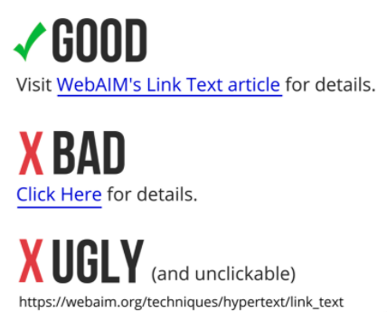
4. HYPERLINK TEXT
TIPS FOR HYPERLINKS
Do not link to text such as “ click here “ or “here”
Use descriptive hyperlinks that make sense out of context and include:
Where the link is going
The purpose of the link
Watch this YouTube video Accessibility in the Classroom or read WebAIM’s article on Links and Hypertext.
Notes:
Descriptive hyperlinks make your content more Operable. URLs are not always human-readable or screen-reader friendly. Many URLs contain combinations of numbers, letters, ampersands, dashes, underscores, and other characters that make sense to scripts and databases but which make little or no sense to the average person. In most cases, it is better to use human-readable text instead of the URL. The human readable link Constructing Accessible Web Sites is more user-friendly than the link to purchase the book by the same title on Amazon.com, which consists of a 108-character link full of numbers, slashes, and text that is not very human-readable. (http://www.amazon.com/exec/obidos/ASIN/1590591488/qid=1116957951/sr=2-1/ref=pd_bbs_b_2_1/103-5755258-8204633)

Slide 15
5. AUDIO AND VIDEO
TIPS FOR AUDIO & VIDEO
Audio materials (.mp3, .wav, etc.) should be accompanied by a transcript
Videos/screencasts should be closed-captioned
Videos created in Canvas Studio can have English captions auto-generated for videos natively recorded in Studio.
Watch this YouTube video Add your own subtitles & closed captions
Notes:
It is important to provide alternative means of consuming audio and video. Even if students aren't visually impaired, they may prefer to read or lack the bandwidth to stream the video. It's not just about accessibility. To use UDL expert Katie Novak's analogy, you're providing a buffet of options so students can select what will suit them best. Perceivable
There are a variety of ways and resources to add closed captioning to your videos and provide transcripts.

Slide 16
ACCESSIBILITY IN CANVAS
Notes:
So how do we do this? We use the Canvas features

Slide 17
ACCESSIBILITY CHECKER
The Rich Content Editor includes an Accessibility Checker tool that checks common errors within the editor.
This tool can help you design course content while considering accessibility attributes.
Notes:
The Rich Content Editor includes an accessibility tool that checks common accessibility errors within the editor. This tool can help you design course content while considering accessibility attributes and is located in the Rich Content Editor menu bar.

Slide 18
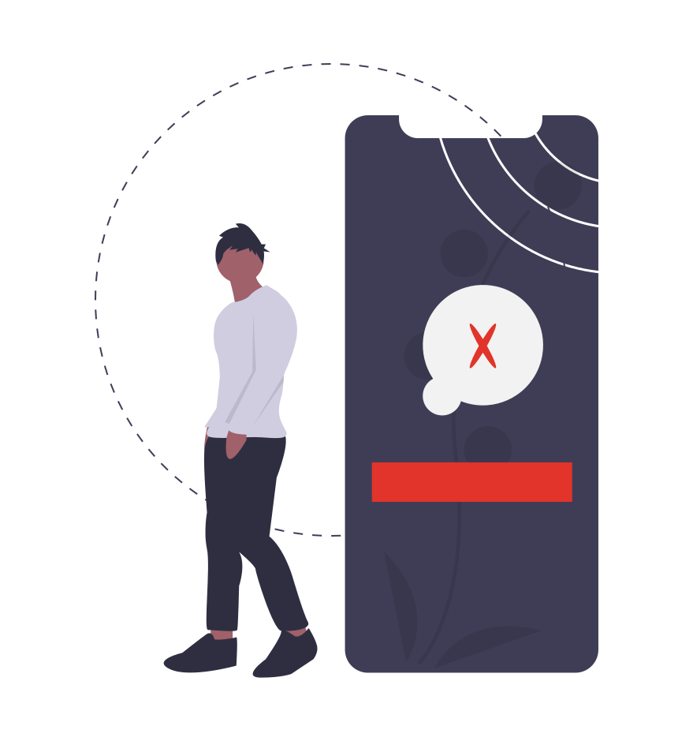
WHAT DOES THE ACCESSIBILITY CHECKER, CHECK?
Adjacent links
Heading paragraphs
Image alt text
Image alt filename
Image alt length
Large text contrast
Lists
Sequential headings
Small text contrast
Table captions
Table header scope
Table header
Notes:
Heading paragraphs: Headings should not contain more than 120 characters.
Image alt text: Images should include an alt attribute describing the image content.
Image alt filename: Image filenames should not be used as the alt attribute describing the image content. Currently, files uploaded directly to Canvas create a redirect that does not properly verify image filenames.
Image alt length: Alt attribute text should not contain more than 120 characters.
Sequential headings: Heading levels should not be skipped (e.g. H2 to H4). However, the tool does not check if the first header starts with H2 or whether the headings are sequential with the rest of the content in the page. Tables do not begin with H1, which is designated for the page title.

Slide 19
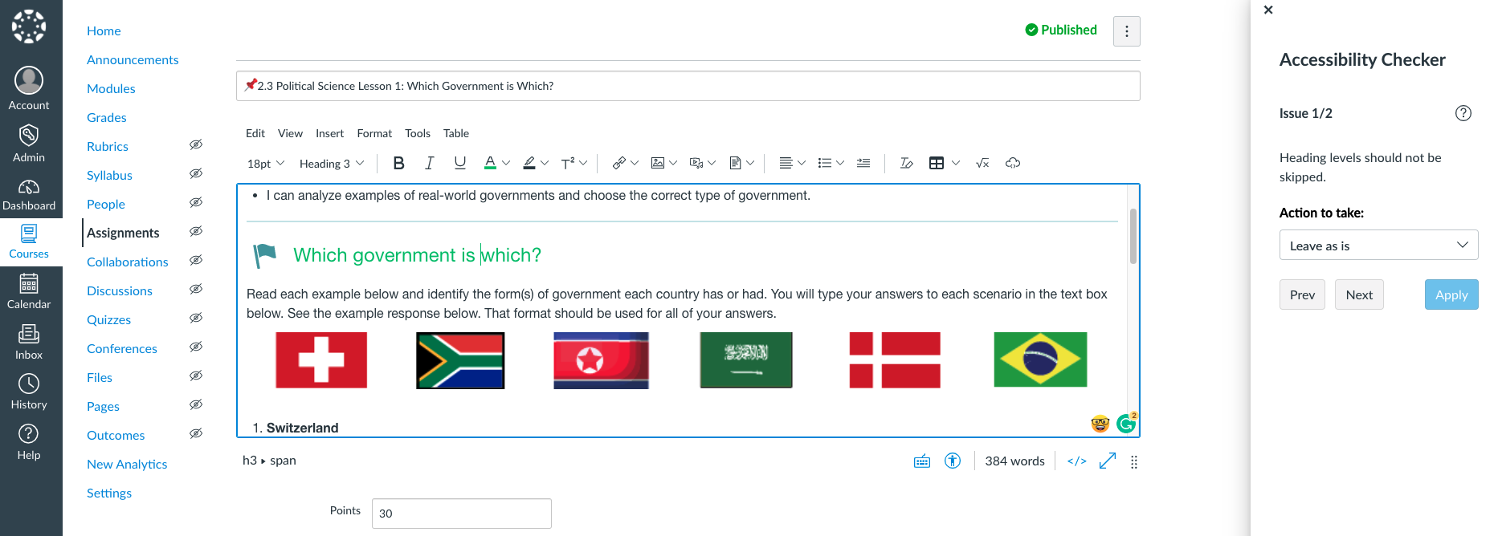
USING THE ACCESSIBILITY CHECKER

Slide 20
TRY IT!
Go to a page in your course and test out the accessibility checker!

Slide 21
WHAT THE ACCESSIBILITY CHECKER DOES NOT CHECK...
Perceivable
Include closed captions and transcripts.
Do not use color alone.
Readable and legible font and text size
Content in files and images that you upload.
Operable
Create descriptive links.
Check for keyboard accessibility.
Provide sufficient time.
Avoid content that flashes.
Accessibility in LTIs
Understandable
Provide clear directions.
Aim for consistency.
Use plain language.
Identify the language.
Robust
Perform an accessibility check.
Test for accessibility with people.
Notes:
Perceivable
Operable
Understandable
Robust
Source: AEM Center

Slide 22
LINK VALIDATOR
The Link Validator searches course content for invalid or unreachable links. You will be given the location and the content of the link error; however it does not automatically fix it for you.

Slide 23
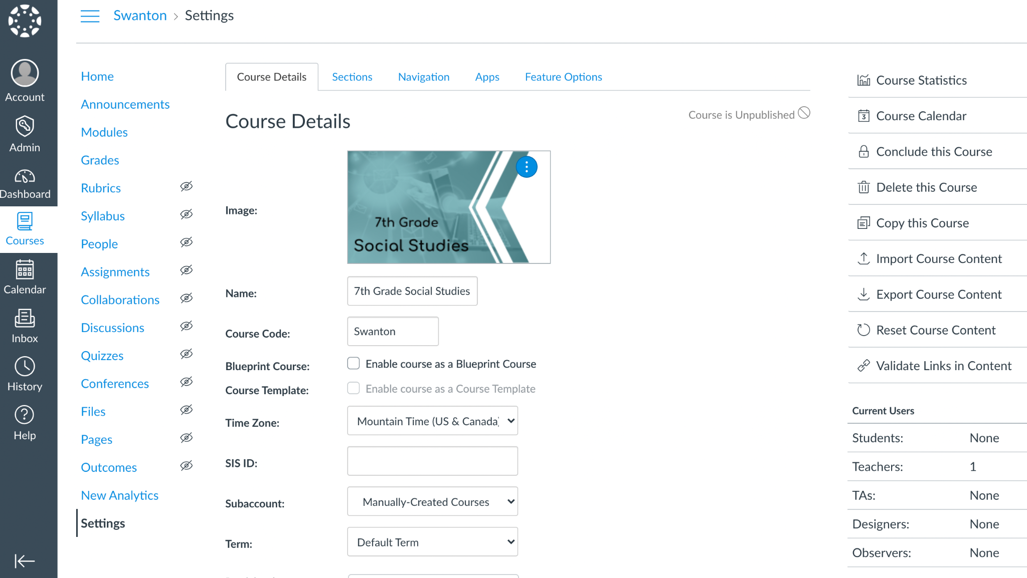
LINK VALIDATOR
2
1

Slide 24
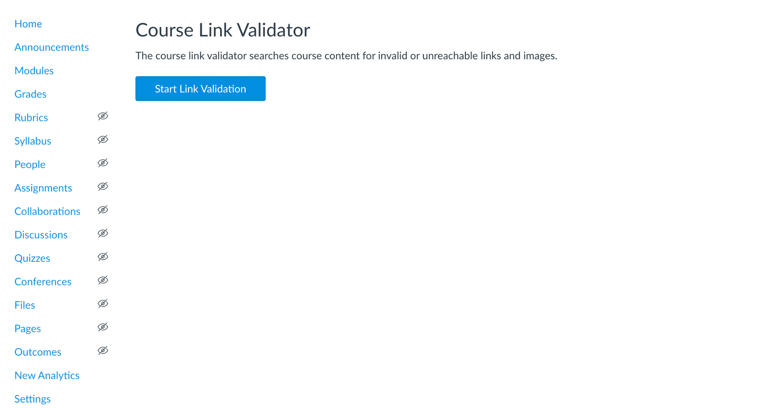
LINK VALIDATOR

Slide 25
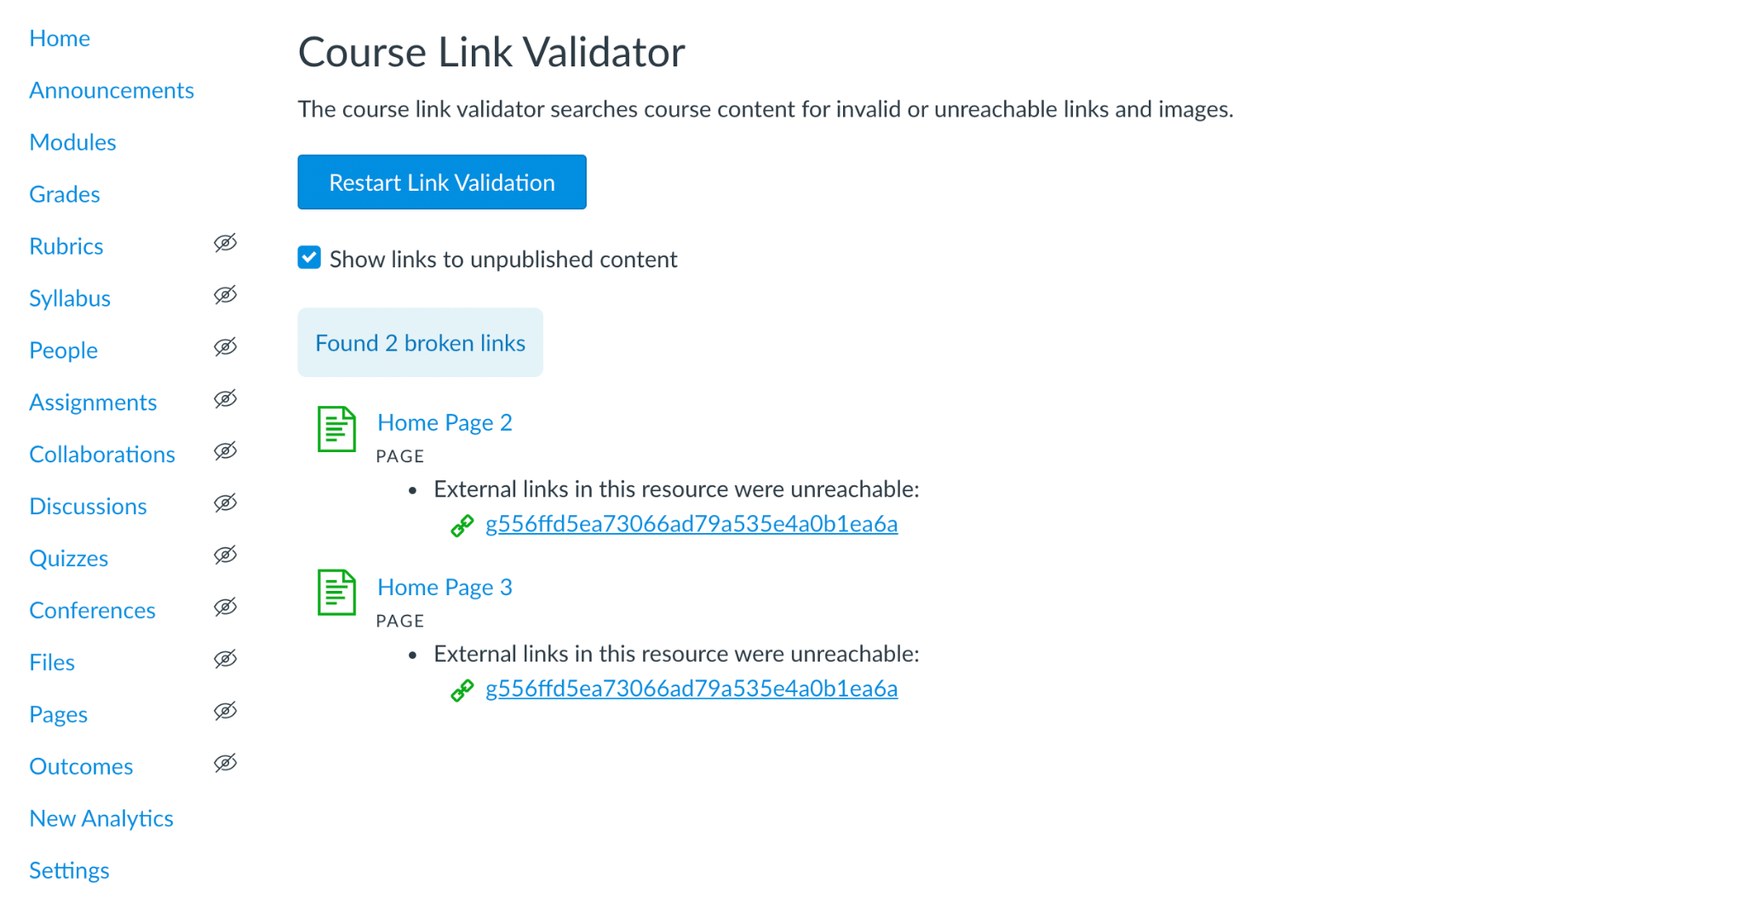
LINK VALIDATOR

Slide 26
TRY IT!
Go to your settings and validate links in your course.

Slide 27
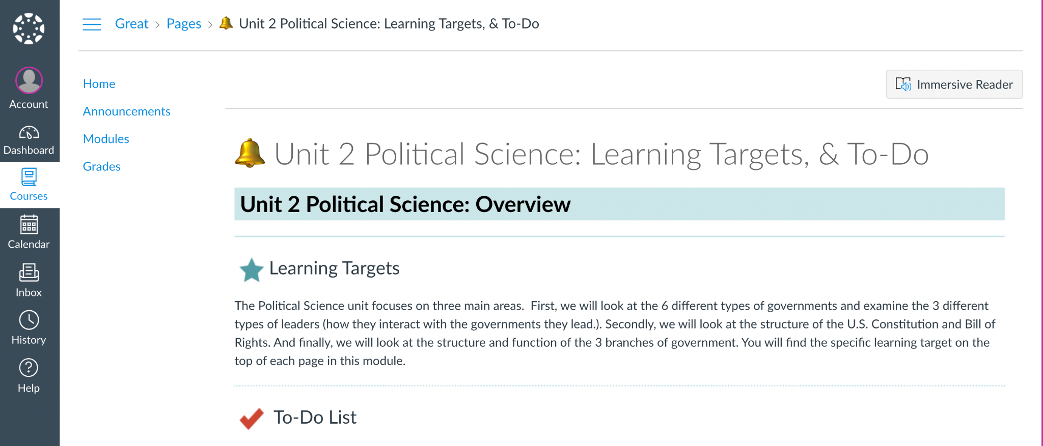
IMMERSIVE READER
The Immersive Reader is a free tool that implements proven techniques to improve reading and writing for people, regardless of their age or ability.
improve reading comprehension and increase fluency for English language learners.
help build confidence for emerging readers learning to read at higher levels, and offer text decoding solutions for learners with learning differences such as dyslexia.
*Must be turned on at the account level.

Slide 28
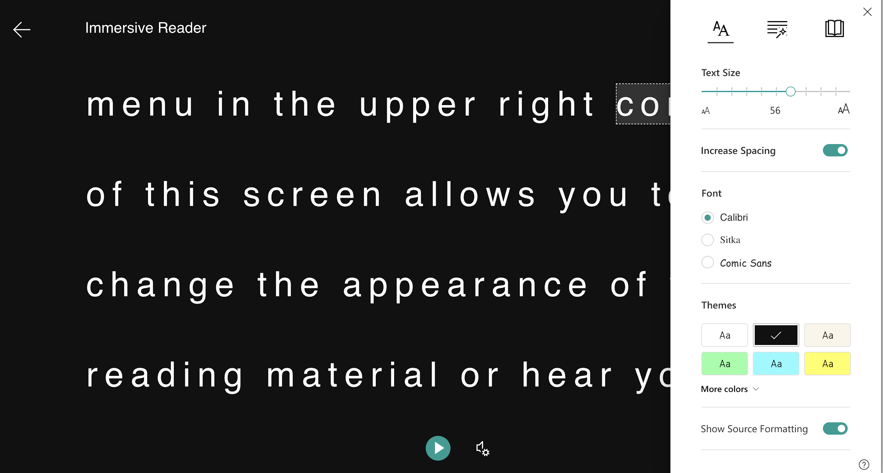
IMMERSIVE READER
Change font size, text spacing, and background color.
Split up words into syllables.
Highlight verbs, nouns, adjectives and sub-clauses.
Read out text aloud, and change the speed of reading.
Picture dictionary

Slide 29
TIPS FOR ACCESSIBLE CONTENT PAGES IN CANVAS

Slide 30
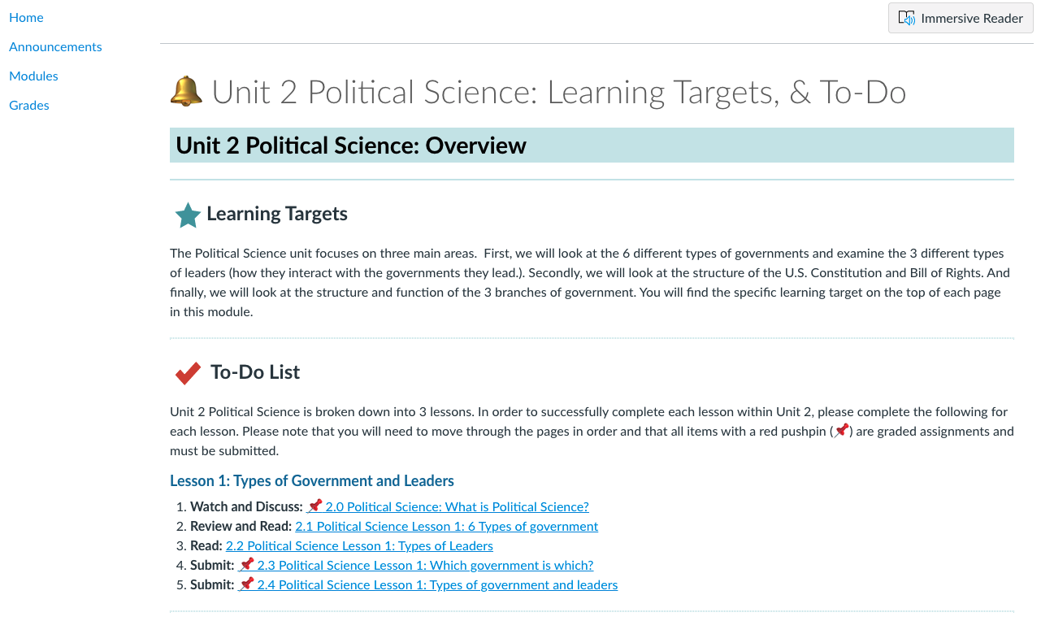
SAMPLE: PAGE
UDL Connections
UDL 1.2: Offers alternatives for auditory information
UDL 4.2: addresses the need to optimize access to tools and assistive technologies.
UDL 7.3: Minimizes threats and distractions
Notes:
Organized layout of content:
Limit course navigation to reduce confusion around navigation
Sequential headings that describe section content
Introduce lessons and highlight expectations
Alignment and indentation: Left alignment is recommended for accessibility
Page Elements
Colors: WebAim Color Contrast Checker
Space: Give your elements space and room to breathe. Use content dividers and horizontal lines to break up content.
Images and graphics: Choose images and graphics that support your content and engage learners visually.
Use emojis as Visual Cues
Tables: Used for tabular data

Slide 31
TIPS FOR ASSESSMENT PAGES IN CANVAS

Slide 32
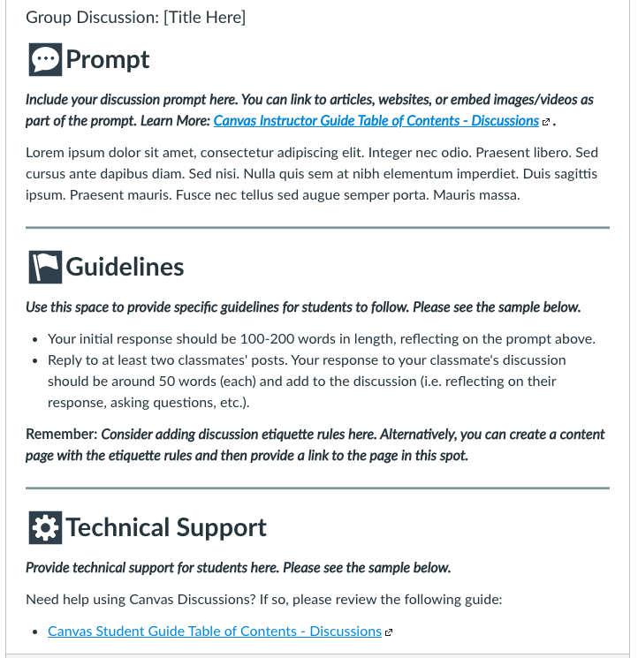
SAMPLE: DISCUSSION
UDL Connections
UDL 3.3: Guide information processing and viaualization
UDL 4.2: addresses the need to optimize access to tools and assistive technologies.
UDL 7.3: Minimizes threats and distractions
UDL 8.1: Heightened salience of goals and objectives
Notes:
Provide an overview/prompt for the assessment when needed.
Provide detailed instructions.
Provide sample assignments to illustrate expectations.
Provide technical support.
Provide feedback. Using Rubrics and SpeedGrader within Canvas can help you easily provide feedback to students.

Slide 33
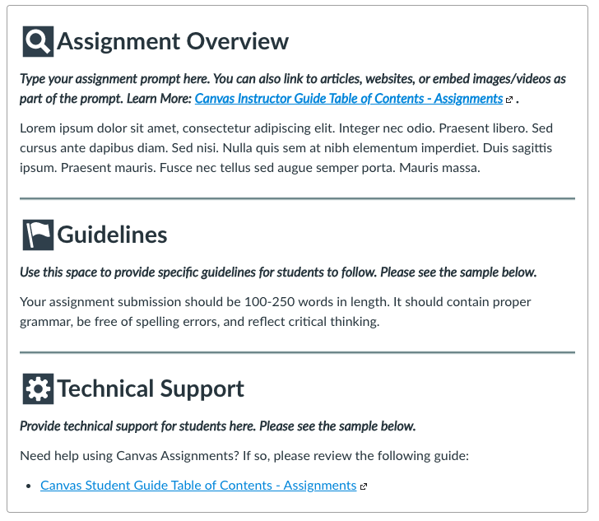
SAMPLE: ASSIGNMENT
UDL Connections
UDL 3.3: Guide information processing and viaualization
UDL 4.2: addresses the need to optimize access to tools and assistive technologies.
UDL 7.3: Minimizes threats and distractions
UDL 8.1: Heightened salience of goals and objectives
Notes:
Provide an overview/prompt for the assessment when needed.
Provide detailed instructions.
Provide sample assignments to illustrate expectations.
Provide technical support.
Provide feedback. Using Rubrics and SpeedGrader within Canvas can help you easily provide feedback to students.

Slide 34
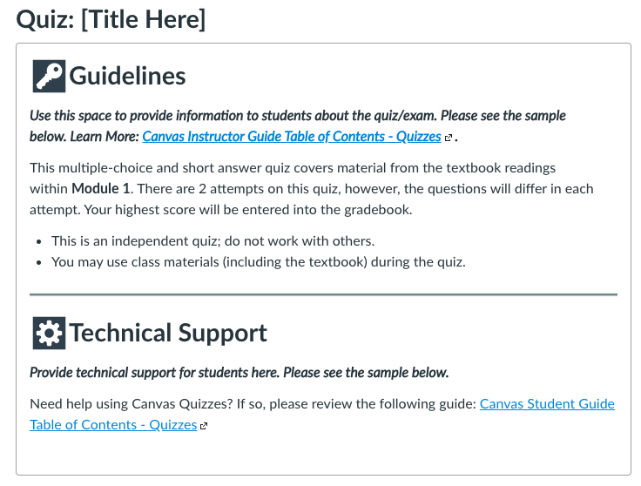
SAMPLE: QUIZ
UDL Connections
UDL 3.3: Guide information processing and viaualization
UDL 4.2: addresses the need to optimize access to tools and assistive technologies.
UDL 7.3: Minimizes threats and distractions
UDL 8.1: Heightened salience of goals and objectives
Notes:
Provide an overview/prompt for the assessment when needed.
Provide detailed instructions.
Provide sample assignments to illustrate expectations.
Provide technical support.
Provide feedback. Using Rubrics and SpeedGrader within Canvas can help you easily provide feedback to students.

Slide 35
Questions and Final Thoughts

Slide 36
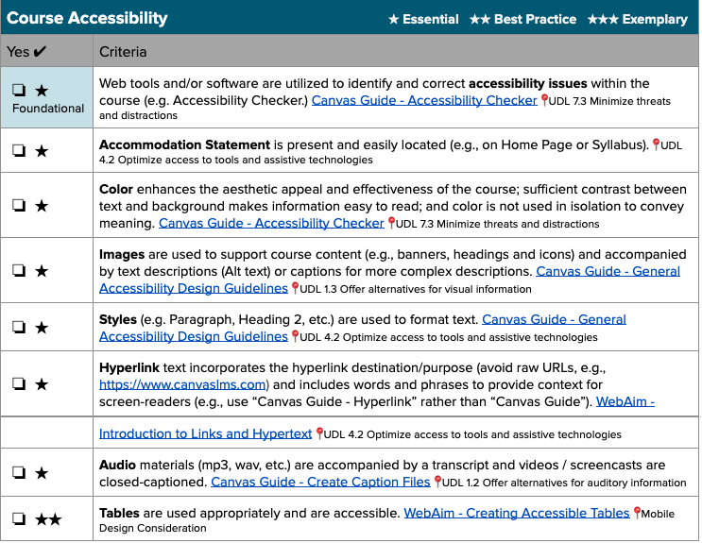
COURSE EVALUATION CHECKLIST
Use this as you are creating your course. It was created by the Canvas Learning Services team to ensure best practices in your course.
Course Evaluation Checklist
Because learners are using Mobile devices, also use the Mobile Design Considerations Checklist in conjunction with the Course Evaluation Checklist.
Mobile Design Checklist
*Make a copy of both!
Notes:
Focus today on *Essential Course Accessibility Elements (⭐️ )
Example Accessibility Statement - ABCSD is committed to providing equal access to students with documented needs. If you have a disability & request accommodation, please contact your Instructor or your Case Worker.

